Slide 1

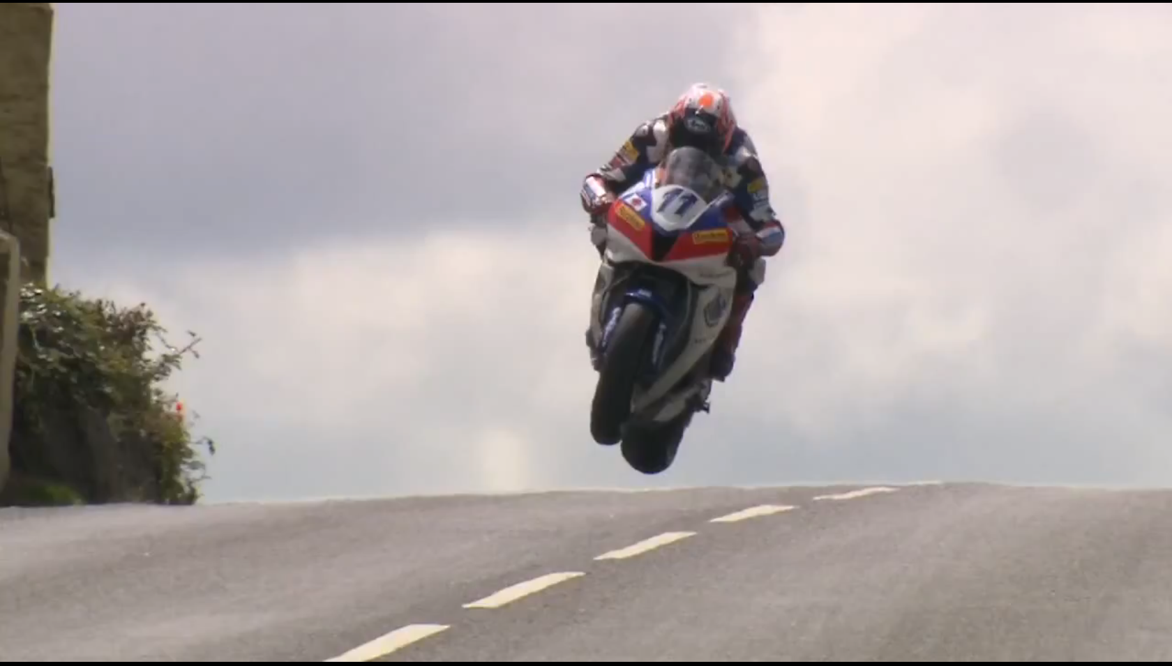
Turen går til Isle of Man

Slide 2
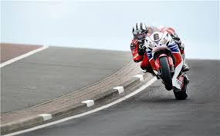
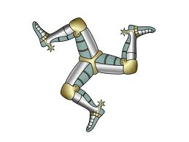
Isle of Man
Agenda
18.00 Fish & Chips
19.00 – Lidt Facts om IOM
Billeder & Fortællinger fra flere ture til Hele of Man
1975. 76, 77, 78 Torben
1986, 2007, 2010 Claus / Mike
2012 Grethe
2013 Jens Toft (Classic TT)
Praktisk info
Budget 2015 / ”Klattens Glæde”
Gode råd
Film: ” The History of the TT” 1907 – 2007 evt. også 2007 - 2013

Slide 3
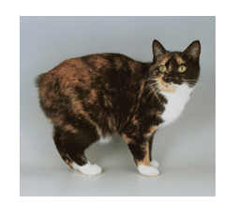
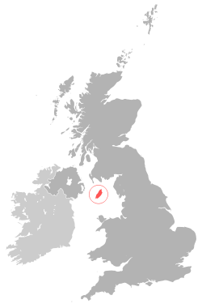
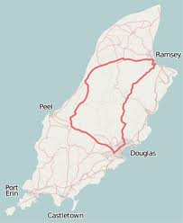
Isle of Man
Areal: 572 km2 (Bornholm 588)
Indbyggere: ca. 85.000
Hovedstad: Douglas 28.000
2. st. Onchan 10.000
Turister til TT: 50-60.000
Sprog: Engelsk, Manx
Valuta: UK eller Manx Pound
GDP: Total $ 2.113 Billion (2010)
Trafik: Venstrekørsel
Dyr: Hjemsted for Manx katten

Slide 4
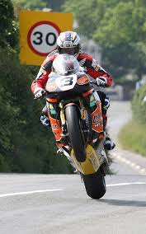
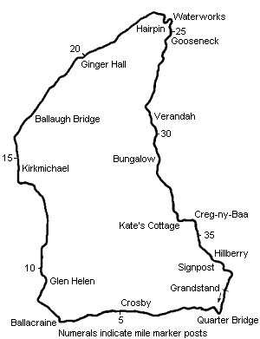
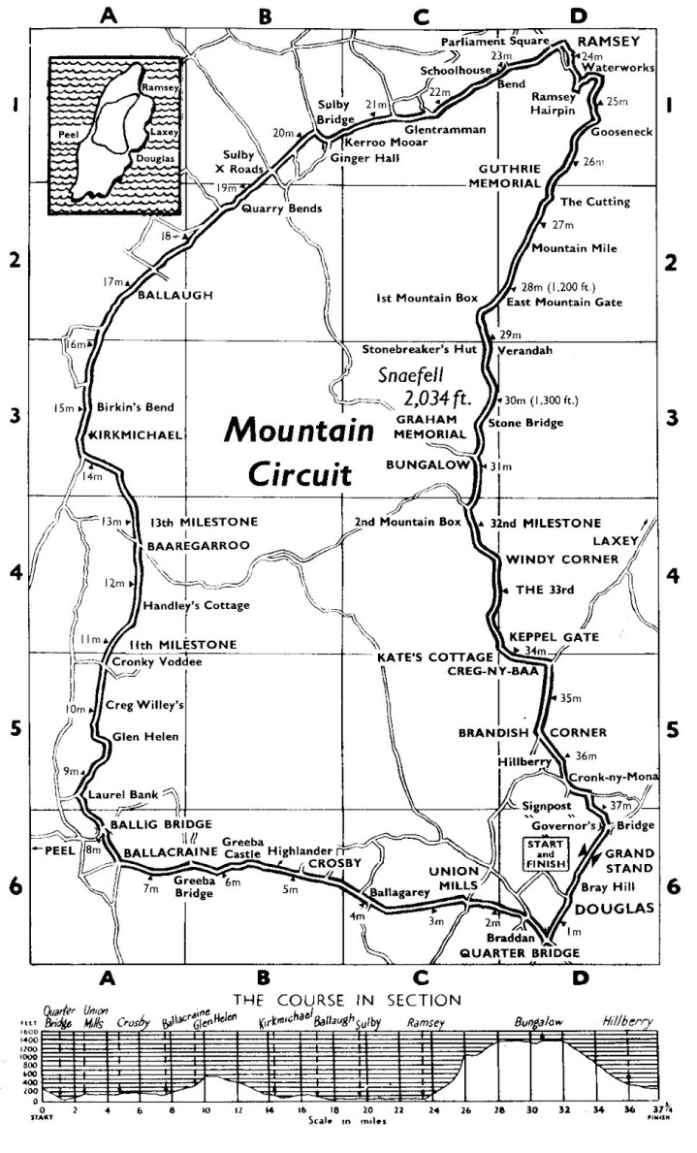
Isle of Man

Slide 5
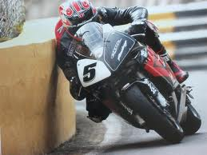
Isle of Man
TT FANZONE & GRANDSTANDS
Each grandstand Fanzone area has seating for the day's races, free Wi-Fi, food and beverage outlets, car parking and toilets.
Main TT Grandstand (1,000 seats) - The TT grandstand is located on Glenrutchery Road, 1.5 miles north west of Douglas Town Centre. This stand is in full view of the start/finish line and the pits where races can be won and lost. You will also see the podium from here and a grandstand ticket can be purchased for an entire race day.
Behind the Grandstand which is in the main TT Village you will find the TT paddock, Beer tent, food and drink outlets along with merchandise stalls and shops. The Snooze box Hotel is also located just a minutes walk.
Nobles Park Fanzone (300 Seats) - The stand was introduced during TT 2013 and its located within the TT village and the entrance for the riders return lane. The return lane is where the riders come off the track after completing the race, expect possible burn outs!
From here you will see the riders race down past the main grandstand and fast speeds as they head towards Bray Hill.
Ballacrye Fanzone (200 Seats) - Just outside the village of Ballaugh the stand is located on the right hand side and offers great views of a fast sweeping left hand corner.
Creg Ny Baa Fanzone (400 Seats) - Very popular part of the course located next to the Creg Ny Baa public house (VIP Entrance only on race days). From here you can see the riders race down the mountain before heading left past the grandstand and onto Brandish. Behind the grandstand you will find a mini TT Village with marquees.

Slide 6
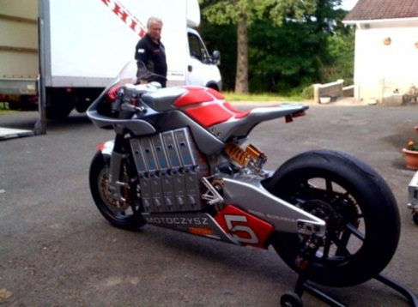
Isle of Man
MORE GREAT VIEWING PLACES TO WATCH
Bray HIll, Douglas - A must for anyone visiting for the first time, Bray Hill will take your breath away! Its a spectacular and very fast section and down hill. Only the top riders shut off slightly at the bottom before heading off to Quarterbridge. Best place to be is at the bottom of Bray Hill where you will see the riders accelerate over Ago's leap.
Braddan Bridge, Outskirts of Douglas - Braddan features seating for around 400 spectators which have a great view of the S-bend or you can watch from the Church grounds. A small charge is made for entrance to both locations.
Glen Helen, St Johns - Glen Helen has good facilities and is also the commentary point for Manx Radio. You can watch from the roadside entrance to the Glen Helen Inn.
Cronk Y Voddy - Located just outside St John's the Cronk Y Voddy straight is a fast section of the course. You can watch from lots of places here but please check with any farmers or marshalls before settling down for the racing. Riders hit 5th and 6th gear through this section.
Kirk Michael Village - Very few spots to watch from but you will be breathless at the speeds though the village as the riders race very close to houses and shops at speeds of upto 180mph!
Ballaugh Bridge, Ballaugh - The home of the famous hump-backed bridge where riders get airborne and then speed away through the village. Good viewing points are visible from both sides of the jump, the Ravan public house also have viewing from its car park.
Sulby Straight, Sulby - 200 mph down the longest straight on the course, need to say no more!
Gooseneck & Gutheries, Mountain section outside of Ramsey - A very popular section with fans, the Gooseneck is a tight right hander which offers a great viewing point while Guthries is a short walk away and features a s-bend.
Creg Ny Baa - A very popular area on the course which is on the run down from Keppel Gate and Kate's Cottage. A great vantage point as the riders race towards the Creg Ny Baa public house then take a right and race towards Douglas.

Slide 7
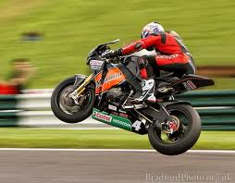
Isle of Man
Isle of Man TT Circuit information
First race | 1907
TT's held | 100+ years
Circuit length (Mountain) | 60.72km / 37.73miles
Superbike TT | 6 Laps - Race distance 364.32km / 226.38miles
Sidecar TT | 3 Laps - Race distance 182.16km / 113.19miles
Superstock TT | 4 Laps - Race distance 242.88km / 150.92miles
Supersport Junior TT | 4 laps - Race distance 242.88km / 150.92miles
Senior TT | 6 Laps - Race distance 364.32km / 226.38miles
TTXGP | 1 Lap - Race distance 60.72km / 37.73miles
Circuit length (Billown) | 6.839km / 4.25miles
Ultra Lightweight 125cc | 8 Laps - Race distance 54.712km / 34miles
Ultra Lightweight 250cc | 8 laps - Race distance 54.712km / 34miles

Slide 8
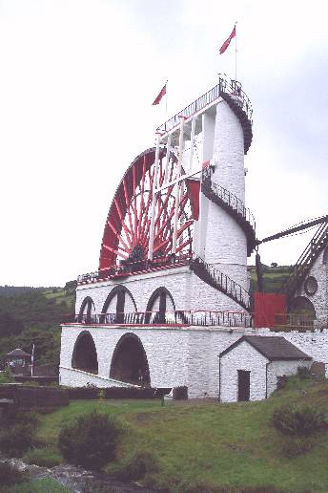
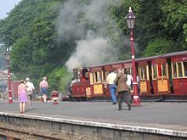
Isle of Man
Nyttige oplysninger
Der findes andet end Race på IOM bl.a.:
Bjerge/klipper, skov, sandstrand, palmer.
Offentlig transport, som: Jernbane fra 1870, trukket af damplokomotiv.
Verdens største vandkraft hjul: 1.100 l/min, kører, men ikke i aktion.
Castle Town (1090) en af de ældste byer på de britiske øer Tidligere hovedstad.
MC & Trike udlejning, 1 runde på TT banen, bagpå ex. Deltagere, helikoptertur mm.
Officielle hjemmeside: http://www.iomttbreaks.com
Div. Film: http://www.dukevideo.com
http://www.retardo.dk/videos.php?id=3637

Slide 9
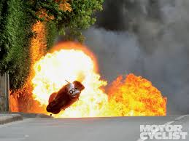
Isle of Man
Gode råd
Hav flere typer påklædning med, vejret kan være meget omskifteligt: eks. 1986 < 10°C / 2010 < 30°C
Tåge og Regn forekommer.
Køb ikke overnatning gennem agenter, brug det officielle turistbureau, eller direkte ved udlejer.
Som gruppe bestil billetter til Færge fra UK - Ise of Man, samt overnatning i sept. Året før man skal afsted.
Vær din egen sikkerhedsrepræsentant, selv om sikkerheden er stor alle steder på banen, så lad være f.eks. at stå i udgang af sving – der er nogen der af og til forlader banen vandret.
Hold godt øje med de andre, der kan evt. komme enkelte newbi Rossier, der dog ikke har lige så meget styr på tingene. Kør defensivt og med hovedet.
Hav kopi af registreringsattesten med, samt SOS international og gult sygesikringsbevis alt. rejseforsikring.

Slide 10
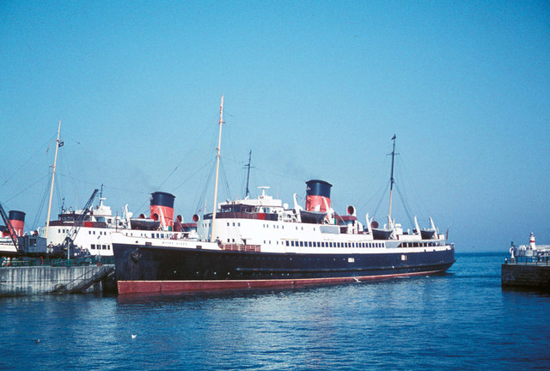
Isle of Man
Rejseplan IOM – 2015
3. Juni 18.45 afgang Esbjerg
4. Juni 12.00 ankomst Harwich (UK)
MC kørsel ca. 430 km / 5-6 timer
Overnatning UK
5. Juni 09.45 afgang Liverpool
12.30 ankomst Douglas (Man) / Check in overnatning
7. Juni ”Mad Sunday” frivillig deltagelse
8 – 12. Juni TT-Races
13. juni 13.45 afgang IOM
16.30 ankomst Liverpool
overnatning UK
14. juni 16.15 afgang Harwich
15. juni 12.30 ankomst Esbjerg

Slide 11
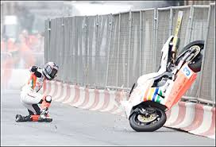
Isle of Man
Budget– 2015 (2014 priser)
*Esbjerg – Harwich: MC + Chaufør: retur inklusive køjeplads i 6 pers kahyt: DKK 1.934,-
aften buffet: 245,-/morgenbuffet 108,- x 2: DKK 353,-
1 Passager DKK (875,-)
*Liverpool – Douglas MC + Chaufør: retur: £ 194,- kurs 9,03 DKK 1.752,-
1 Passager £ 85,- / DKK 768
2 overnatninger i UK 1 ud/1 hjem £ 70,- kurs 90,3 DKK 632,-
Mad 11 dg á 150,- DKK 1.650,-
Overnatninger Isle of Man: 6.-13. juni DKK 3.600,-
Benzin ca. 2.200 km /15 km/l á kr. 12/l DKK 1.760,-
---------------------
Total DKK 11.681,-
MC m/ passager, hvor alle udgifter deles reduceres priser m/ 2.665,-
* Bestilles/betales ½ september ½ Februar

Slide 12
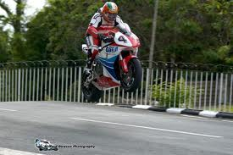
Isle of Man
”Klattens glæde”

